Slide 1
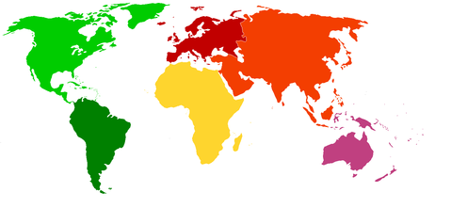
Europe Geography Review!!!
Click to Reveal Countries/Features

Slide 2
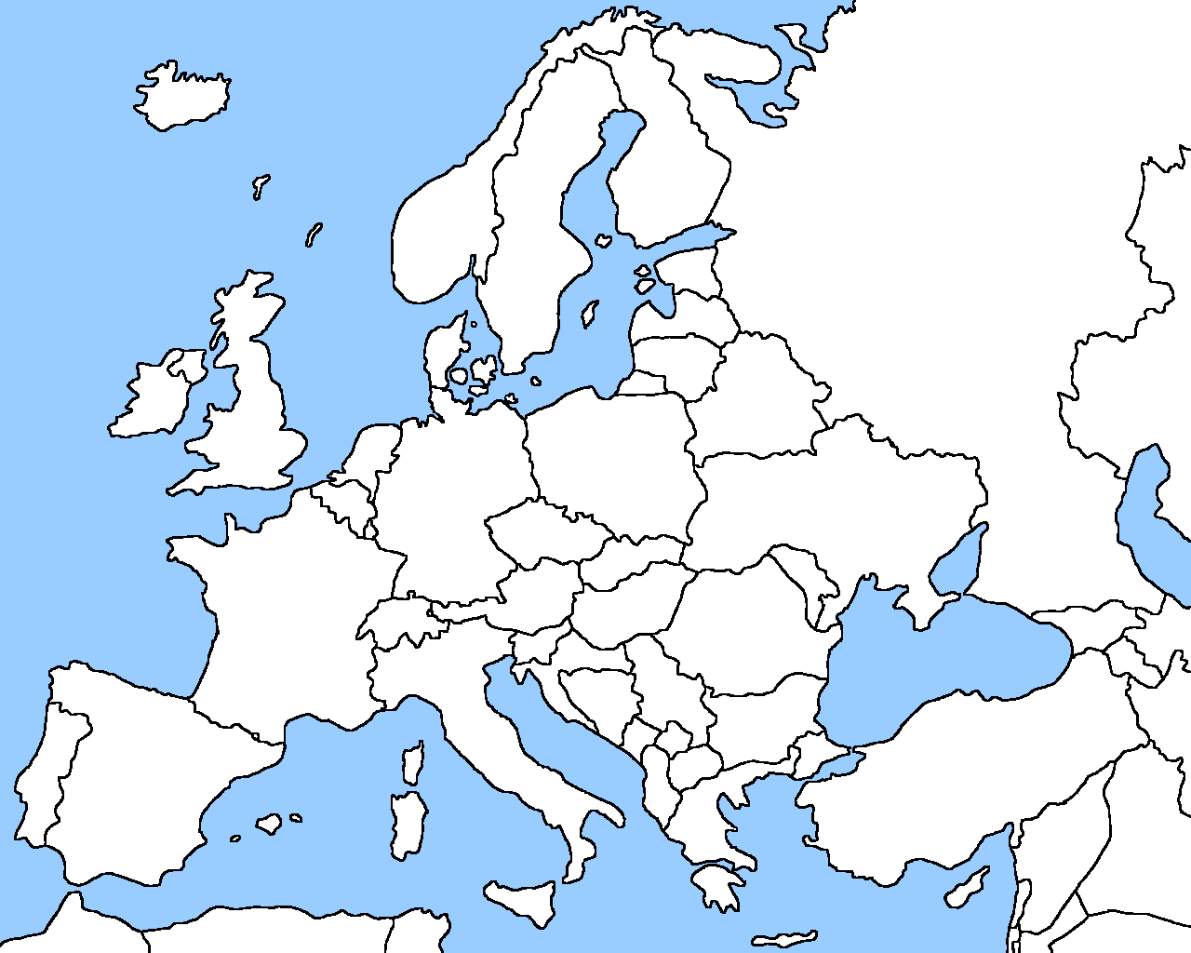
Europe: Countries
Russia
UK
Poland
B
Germany
Ukraine
France
Italy
Spain

Slide 3
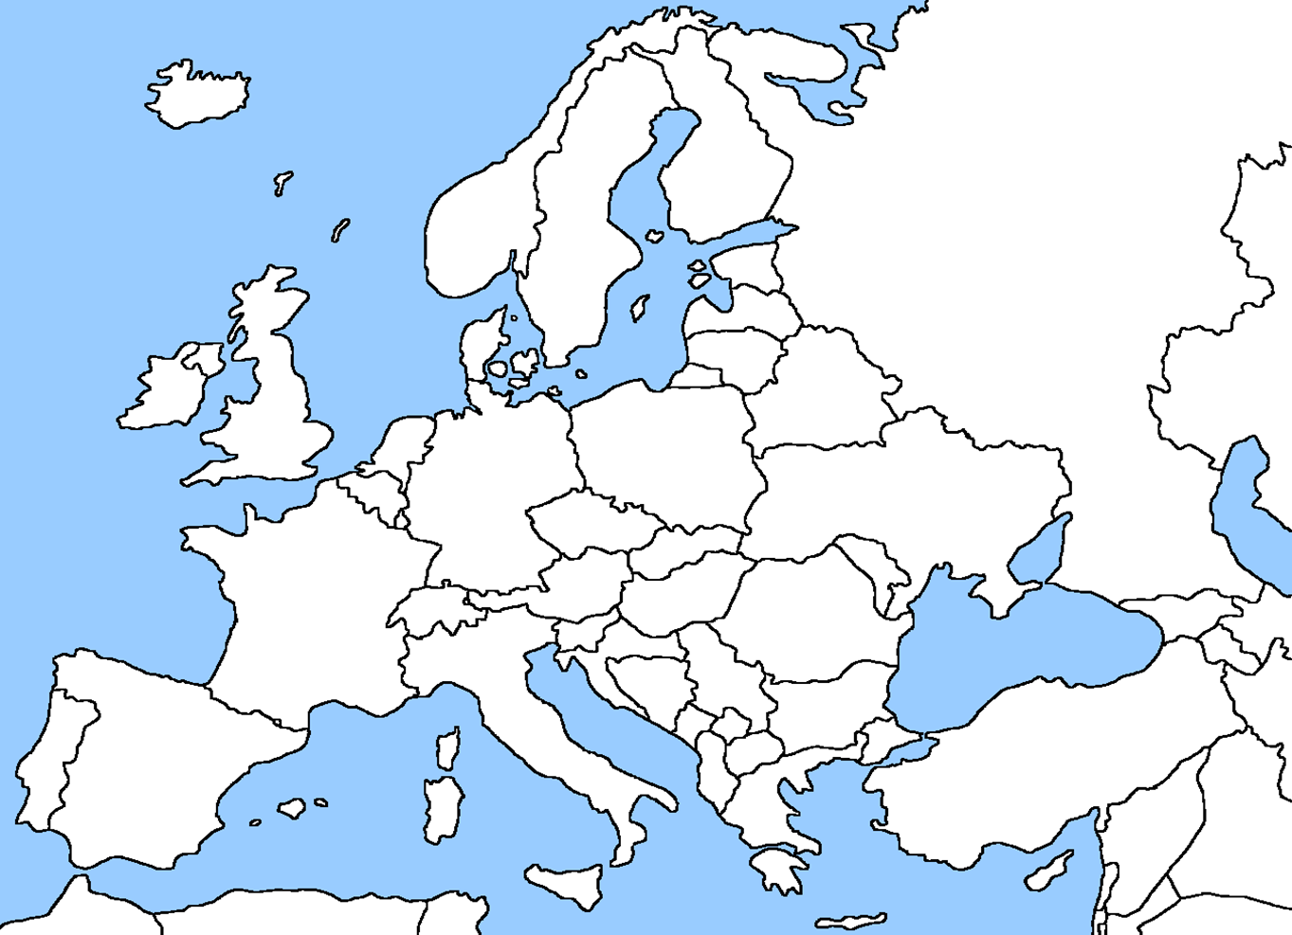
Europe: Physical Features
Ural Mountains
Scandinavian
European Plain
English Channel
Rhine
Danube
Pyrenees
Alps
Iberian
Peninsula
Mediterranean Sea

Slide 4
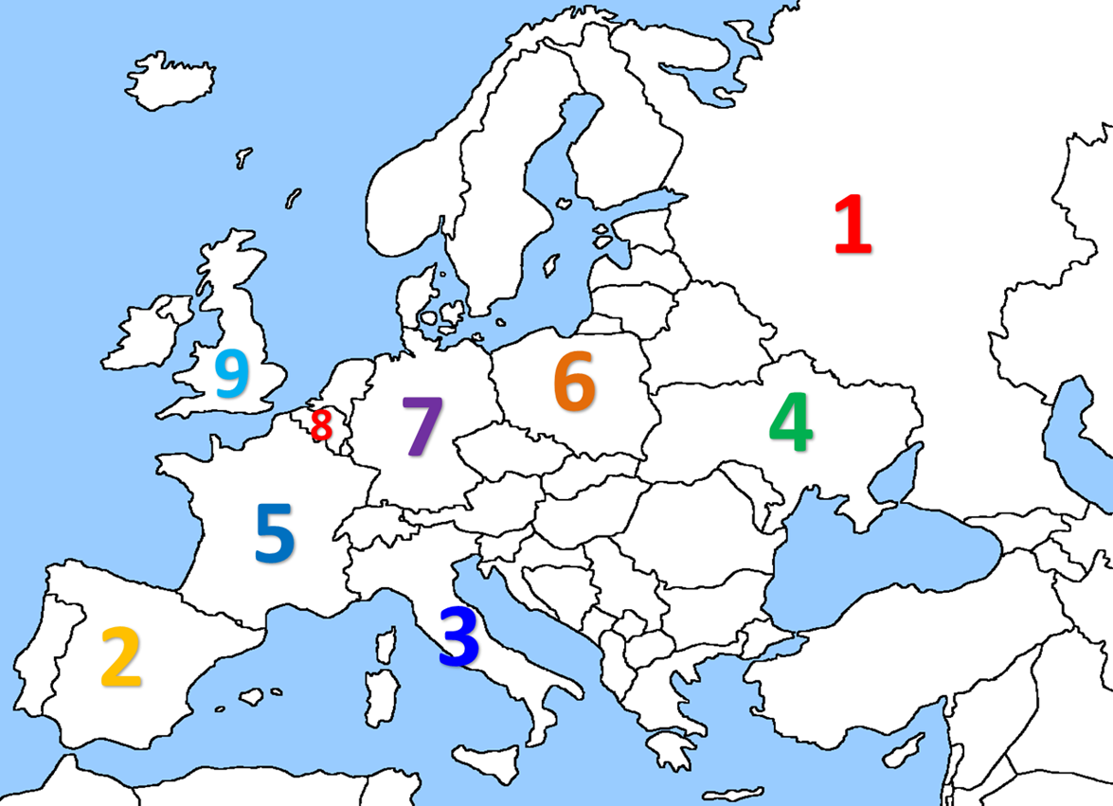
Europe: Countries

Slide 5
