Slide 1
Environmental Issues
1. Acid rain is a major environmental issue in Germany. What causes acid rain?
burning of coal, gas, and oil by cars, factories, and power plants
2. Air pollution is a major environmental issue in the United Kingdom. What causes air pollution?
pollutants from factories and automobiles
3. Describe what happened in Chernobyl in 1986:
A nuclear reactor at the power plant exploded and radiation affected the area

Slide 2
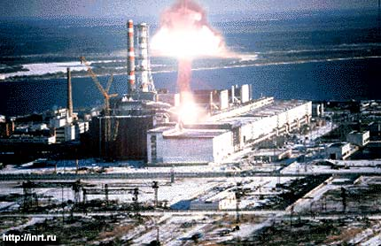
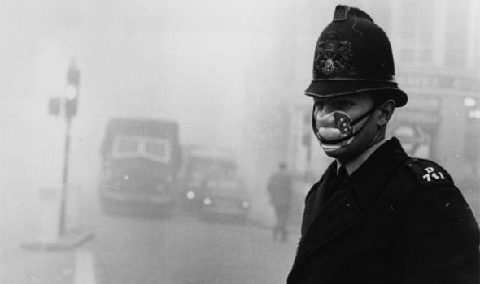
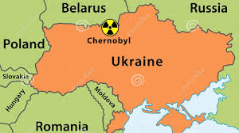
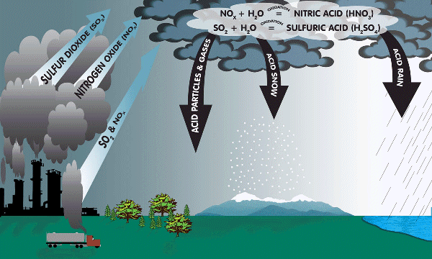

Slide 3
Environmental Issues
Brazil
4. Deforestation is a major issue in _______________ due to logging, cattle (cow) ranching and crop cultivation (farming).
5. Air pollution is a major issue in ____________________ because the city is bowl-shaped; the Sierra Madre mountains also trap the polluted air.
6. Oil pollution is a major issue in _______________. The economy of this country is dependent upon oil production.
Mexico City
Venezuela

Slide 4
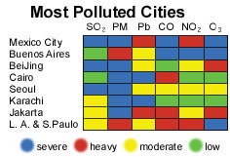
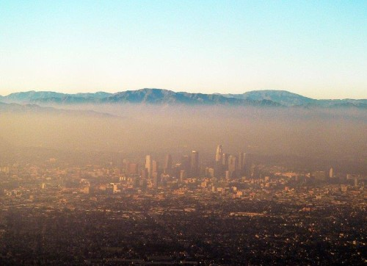
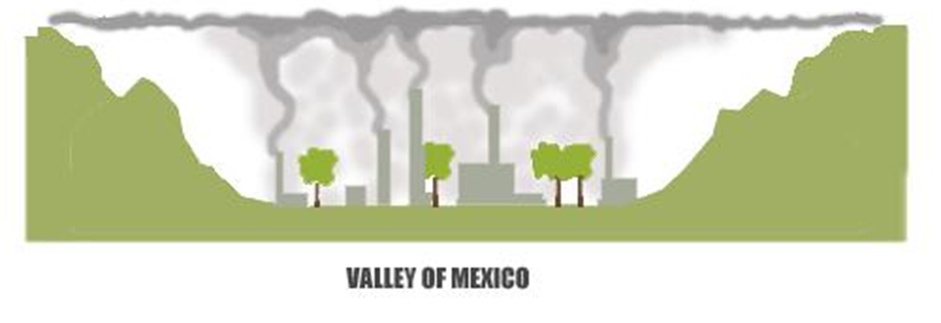

Slide 5
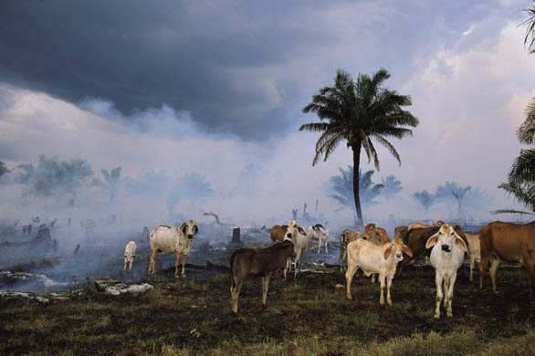
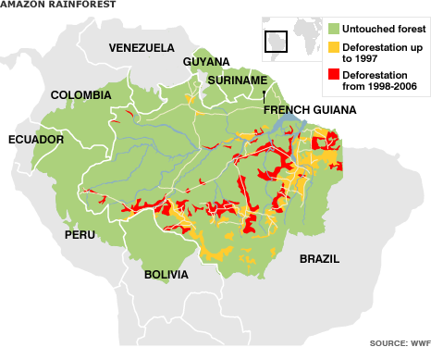
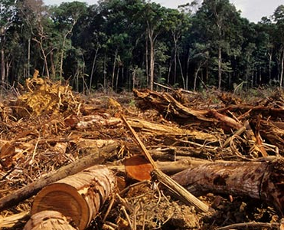
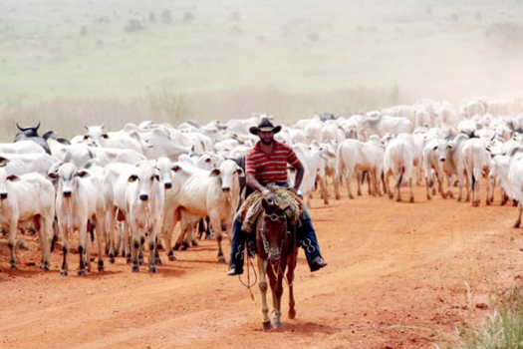
Cattle Ranching!

Slide 6
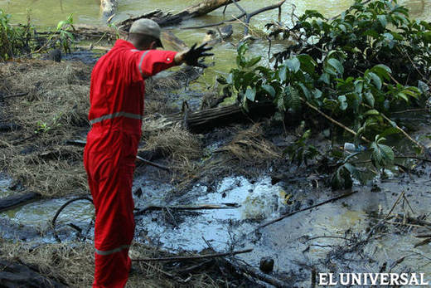
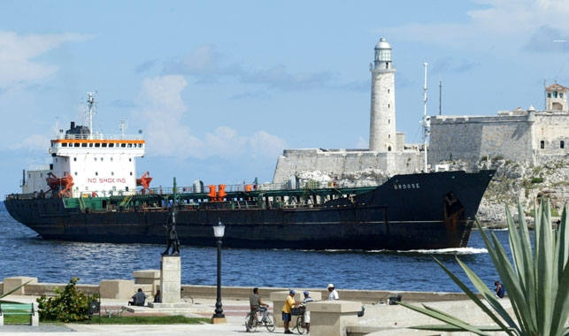
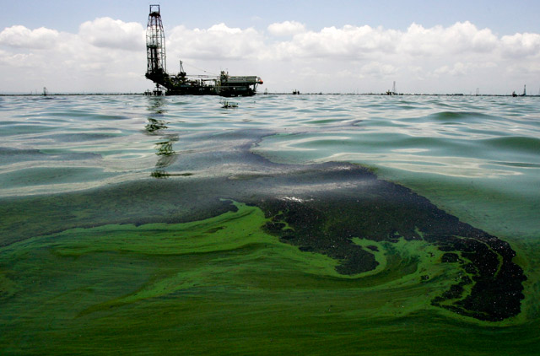
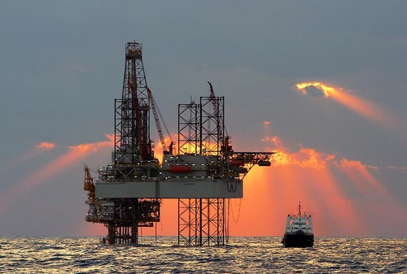

Slide 7
Environmental Issues
7. What is a major source of drinking water in Canada?
8. What causes acid rain in Canada?
9. What is being extracted from the Canadian Shield?
10. What industry has led to the clear-cutting and destruction of trees?
The Great Lakes
(which are becoming polluted)
Pollutants such as SO2 from cars and factories
Natural Resources
Timber/ logging Industry

Slide 8
