Slide 1
Human-Environmental Interaction Review

Slide 2
Answer
A

Slide 3
Human-Environmental Interaction Review
2. Which of these is MOST LIKELY to be classified as a reason for Canadians' concern about pollution of the Great Lakes?
The Great Lakes are a favorite Canadian tourist destination.
The Great Lakes are a major source of Canada's drinking water.
Canadians prefer the beaches along the Great Lakes to those along the coast.
Diving on shipwrecks is a growing Great Lakes sport which attracts divers from around the world.

Slide 4
Answer
B

Slide 5
Human-Environmental Interaction Review
What are the main causes of acid rain in Germany and Canada?
A. farms and forests
B. water power and electricity
C. coal burning factories and automobile emissions
D. solar power and wind turbines

Slide 6
Answer
C

Slide 7
Human-Environmental Interaction Review
What is the main cause of air pollution in the United Kingdom today?
A. factory smoke
B. use of fossil fuels
C. automobile exhaust emissions
D. all of the above

Slide 8
Answer
D

Slide 9
Human-Environmental Interaction Review
After 1986, Chernobyl, Ukraine was abandoned. What environmental issue caused the city to be abandoned?
A. The nuclear power plant exploded and radiation levels were unsafe.
B. The people were being persecuted by soldiers of the Soviet Union.
C. The Chernobyl River was diverted so there was no drinking water.
D. The area was under water because of the construction of a dam.

Slide 10
Answer
A

Slide 11
Human-Environmental Interaction Review
What natural resource does Venezuela’s economy depend upon but negatively impacts the country’s environment?
A. Timber
B. Oil
C. Coal
D. Other minerals

Slide 12
Answer
B

Slide 13
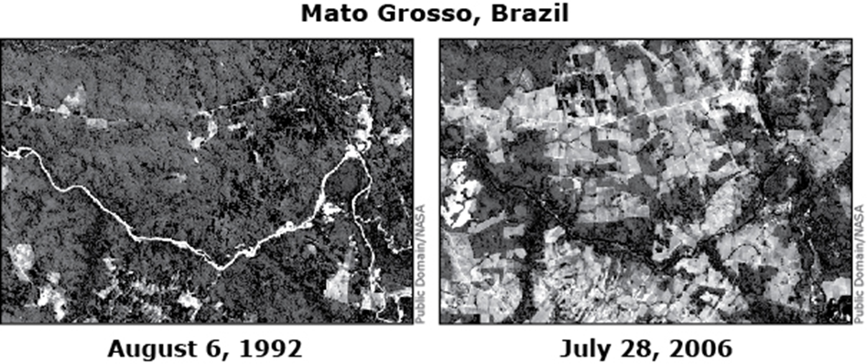
Human-Environmental Interaction Review
7. The ecology of Brazil's rain forest is most threatened by which of these human activities?
A. building dams
B. drilling for oil
C. cutting down trees
D. draining swamps

Slide 14
Answer
C

Slide 15
Human-Environmental Interaction Review
Where in Canada are the most valuable mineral resources found and extracted?
A. Hudson Bay
B. Canadian Shield
C. Golden Horseshoe
D. St. Lawrence Seaway

Slide 16
Answer
B

Slide 17
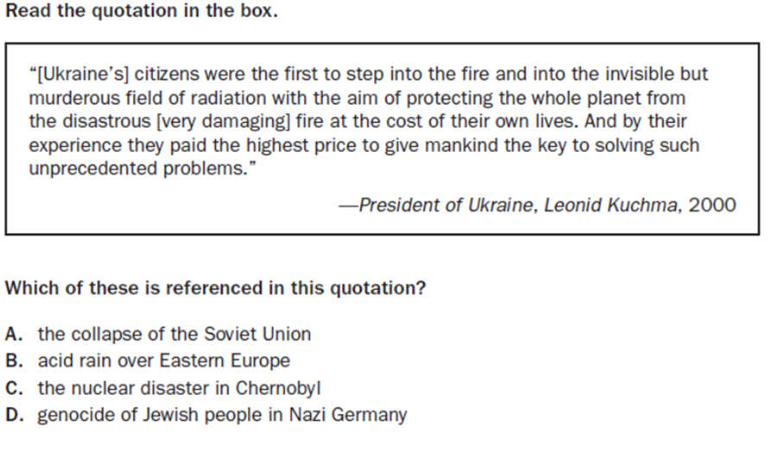
Human-Environmental Interaction Review
9.

Slide 18
Answer
C

Slide 19
Human-Environmental Interaction Review
Why does Mexico City, Mexico have such high levels of air pollution?
A. The city has a dense population
B. The location of the city is in a valley, surrounded by mountains which traps the pollution
C. Environmental laws are not strictly enforced in Mexico
D. All of the above

Slide 20
Answer
D

Slide 21
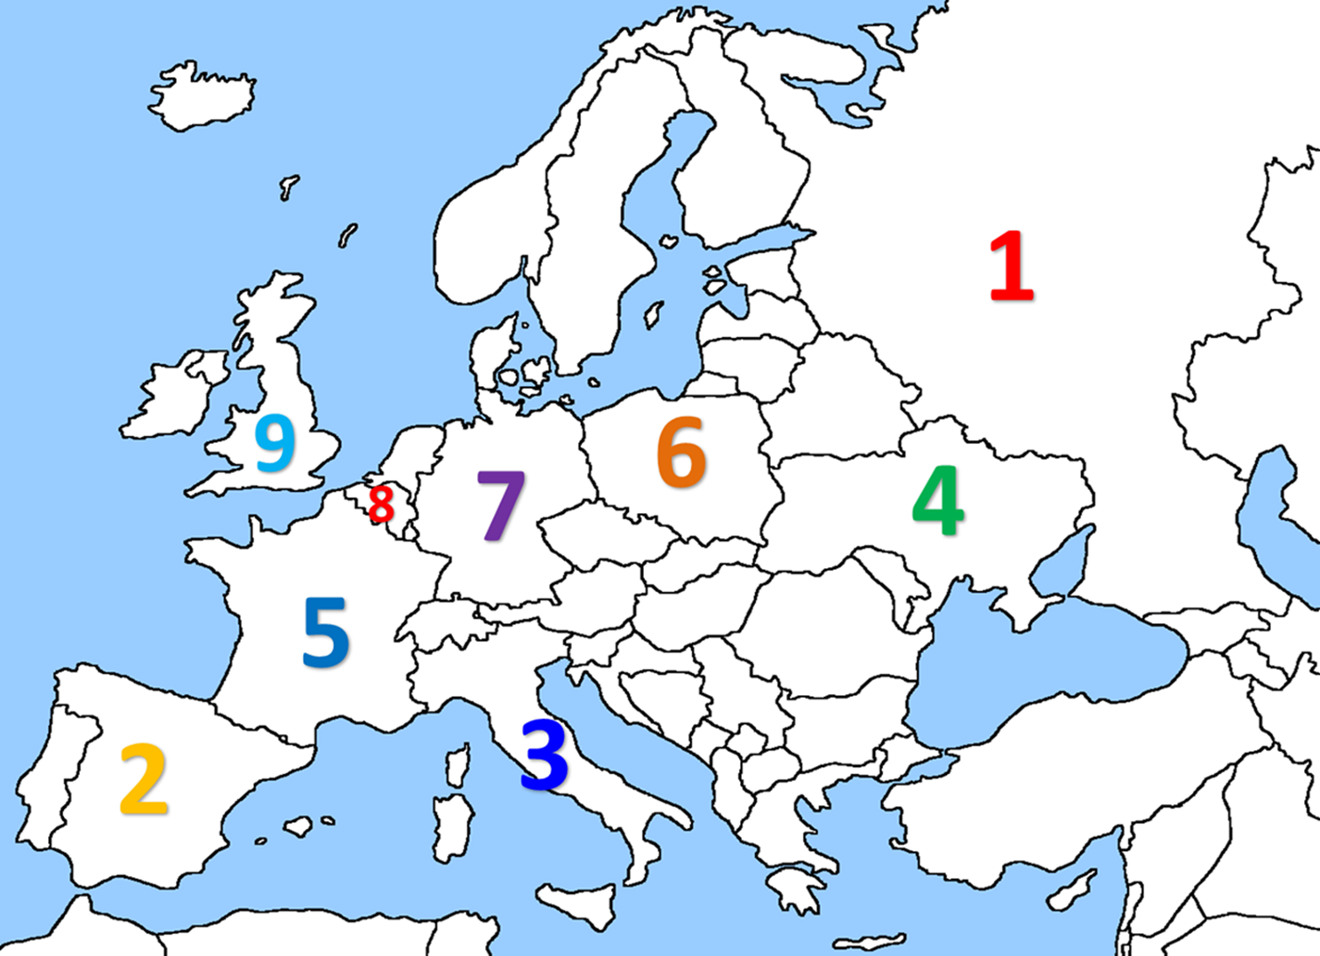
Human-Environmental Interaction Review
11. In which European country is acid rain a major environmental issue?
8
7
4
1

Slide 22
Answer
B, Germany (7)

Slide 23
Human-Environmental Interaction Review
12. In which European country is smog a major environmental issue?
2
3
9
6

Slide 24
Answer
C, United Kingdom (9)

Slide 25
Human-Environmental Interaction Review
13. In which European country did a natural disaster occur?
4
5
1
9

Slide 26
Answer
A, Ukraine (4)

Slide 27
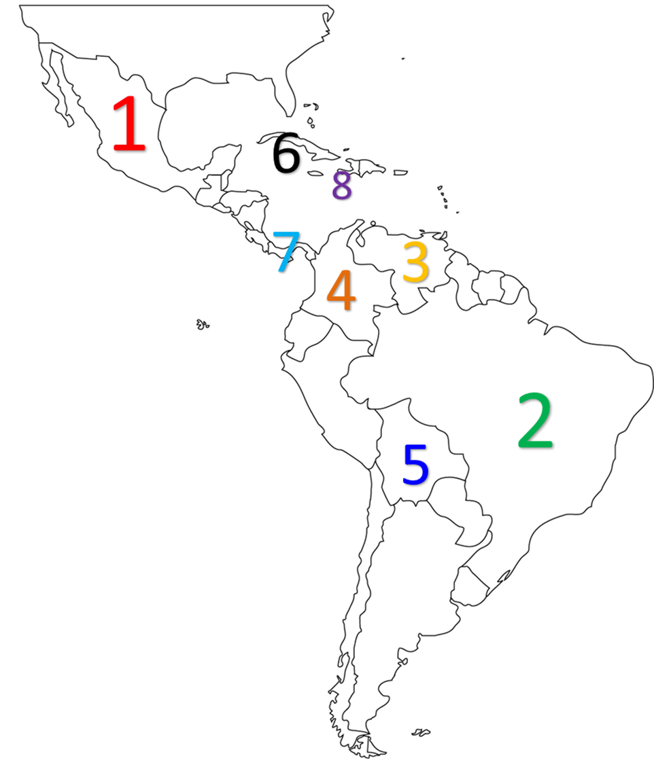
Human-Environmental Interaction Review
14. In which Latin American country is air pollution a major environmental issue?
6
5
4
1

Slide 28
Answer
D, Mexico (1)

Slide 29
Human-Environmental Interaction Review
15. In which Latin American country is oil pollution a major environmental issue?
8
7
3
5

Slide 30
Answer
C, Venezuela (3)

Slide 31
Human-Environmental Interaction Review
16. In which Latin American country is deforestation a major environmental issue?
2
6
1
4

Slide 32
Answer
A, Brazil (2)

Slide 33
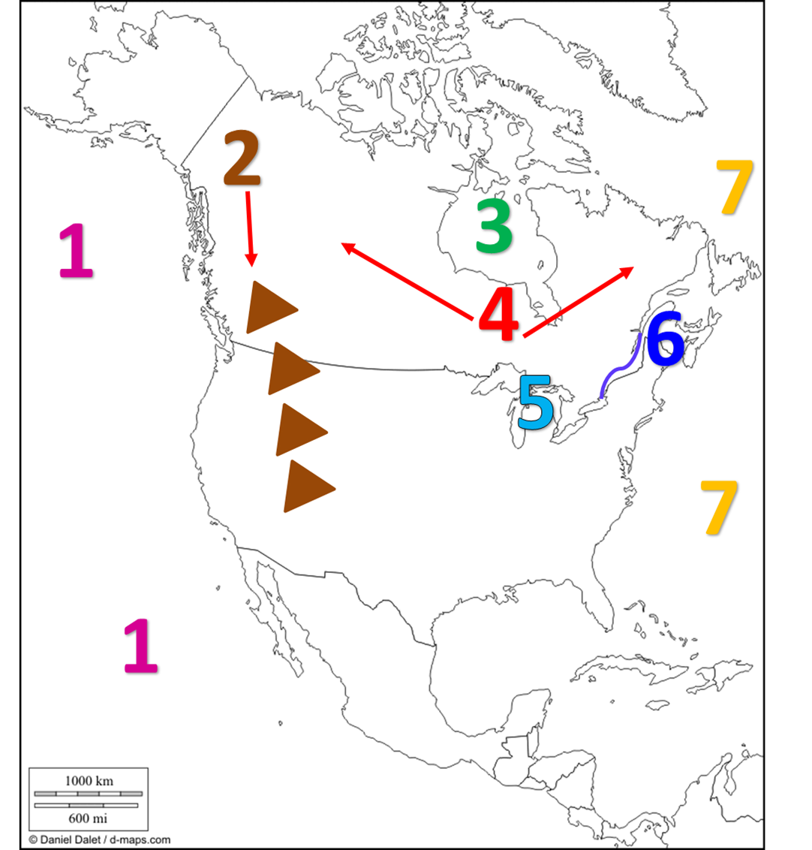
Human-Environmental Interaction Review
17. Which physical feature is a major source of drinking water for Canadians but is heavily polluted?
7
5
3
2

Slide 34
Answer
B, The Great Lakes (5)

Slide 35
Human-Environmental Interaction Review
18. In which physical feature can valuable minerals be found?
1
4
2
6

Slide 36
Answer
B, The Canadian Shield (4)

Slide 37
Human-Environmental Interaction Review
19. Fill in the lyrics: “Acid rain in Germany is a real big problem can’t you see. Its caused by ____________ from factories and people driving in the streets.”
A. Deforestation
B. Pollution
C. Smoke
D. Radiation

Slide 38
Answer
C

Slide 39
Human-Environmental Interaction Review
20. Fill in the lyrics: “Deforestation caused by _______________ and cattle ranching. Clearing all the trees to grow soy beans and for logging.”
A. Timber
B. Oil
C. Minerals
D. Farming

Slide 40
Answer
D

Slide 41
Human-Environmental Interaction Review
21. Fill in the lyrics: “Don’t forget Chernobyl. _________________ causing tumors. A nuclear reactor at the power plant exploded.”
A. Asthma
B. Pneumonia
C. Radiation
D. Smog

Slide 42
Answer
C

Slide 43
Human-Environmental Interaction Review
22. What is SO2?
A. Sulfur Dioxide
B. Carbon Dioxide
C. Nitrogen Dioxide
D. Water

Slide 44
Answer
A

Slide 45
Human-Environmental Interaction Review
23. Fill in the lyrics: “20 percent of the world’s oxygen comes from the _____________________, yo!”
A. Amazon
B. Canadian Shield
C. European Plain
D. Mediterranean

Slide 46
Answer
A

Slide 47
Human-Environmental Interaction Review
24. Fill in the lyrics: “Chemicals they blow-oh, into the air you know-oh, _____________________ then flow-ohs, down to the earth Oh No-oh!”
A. Radiation
B. Acid rain
C. Minerals
D. Factories

Slide 48
Answer
B

Slide 49
Human-Environmental Interaction Review
25. Fill in the lyrics: “Canada also has acid rain too. High levels of ________. Property can be damaged too like landmarks, art and statues.”
A. Smog
B. Radiation
C. SO2
D. H2O

Slide 50
Answer
C

Slide 51
Human-Environmental Interaction Review
26. Cause or Effect?
Cancer due to radiation exposure was the result of the nuclear explosion at Chernobyl.
A. Cause
B. Effect

Slide 52
Answer
B

Slide 53
Human-Environmental Interaction Review
27. Cause or Effect?
Factory smoke and automobile emissions lead to air pollution in Mexico and the United Kingdom.
A. Cause
B. Effect

Slide 54
Answer
A

Slide 55
Human-Environmental Interaction Review
27. Cause or Effect?
Cattle ranching, agriculture (farming) and building homes in the Amazon rainforest is the reason why deforestation happens in Brazil.
A. Cause
B. Effect

Slide 56
Answer
A

